Slide 1
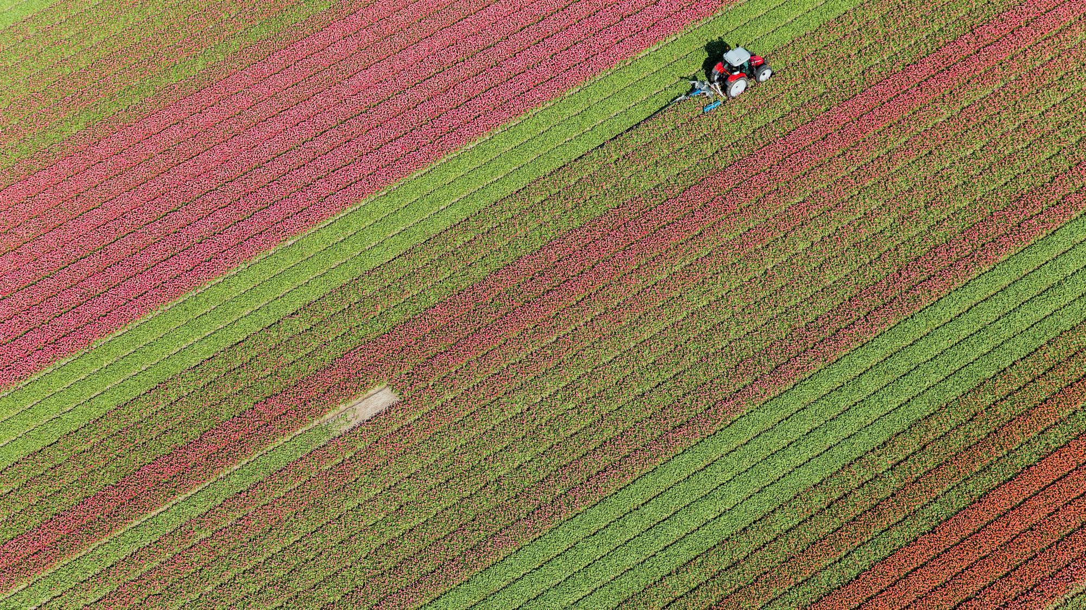
Sachin Adulkar – 18101B0067 Vivek Pawar – 18101B0070 Shubham Kothekar – 16101B0018 Aniket Choudhary – 19101B0030
HARVESTIFY-Crop Disease Detection and Fertilizer Suggestion
Presenter Name
Guide- prof. Shruti Agrawal

Slide 2
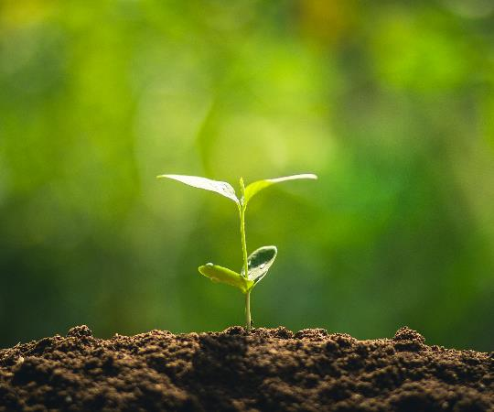
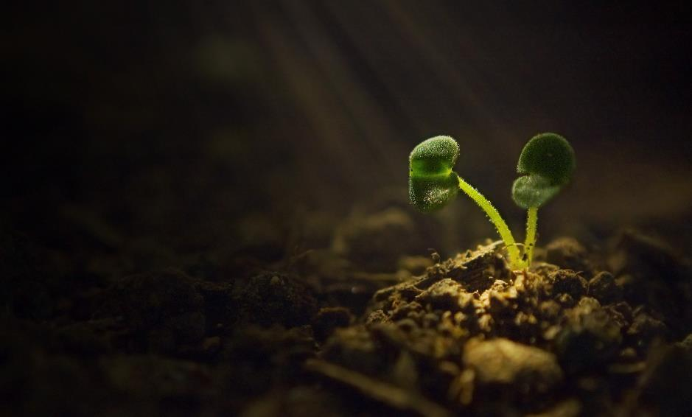
Problem statement
In country like India, majority of the population is dependent on agriculture for their livelihood.
Major problem behind loss in agriculture industry is the spread of unknown plant diseases.
This plant diseases create major problem as they can destroy the whole farm of cultivation in months , as most of plant diseases are unknown and new for farmers , their remedies are unknown too
Adding any random fertilizer can destroy the plants totally and can degrade the quality of soil.

Slide 3
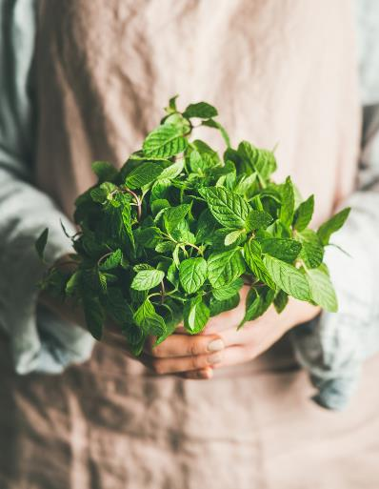
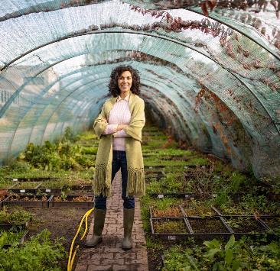
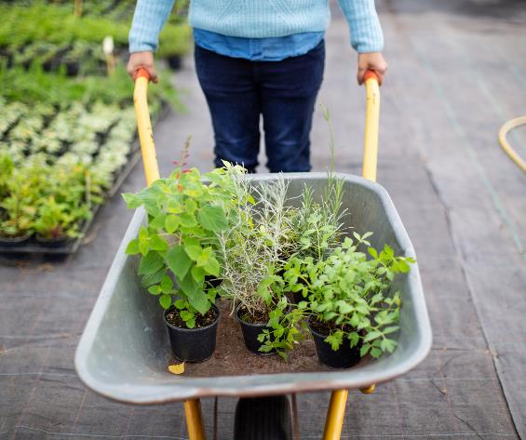
Summary
Farmers face several challenges when growing crops
In India, a major fraction of farmers do not have the knowledge to select appropriate crops and fertilizers.
Crop failure due to disease causes a significant loss to the farmers, as well as the consumers.
To this end, we create an open-source easy-to-use web application to address some of these issues
which may help improve crop production. In particular, we support crop recommendation, fertilizer recommendation, plant disease prediction, and an interactive news-feed.

Slide 4
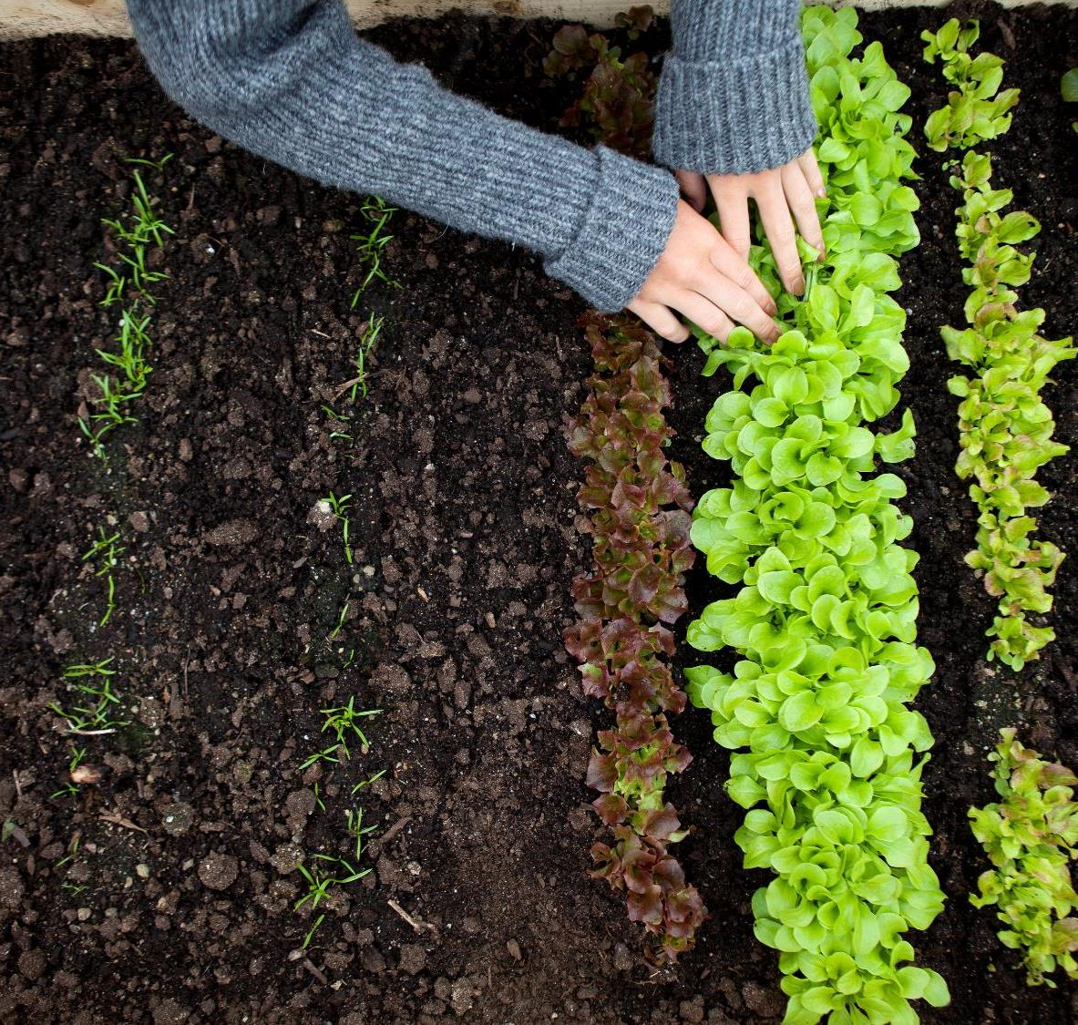
Goals
To detect the plant infection or disease by identifying the colour feature of the leaf area
To recommend fertilizers based on given inputs from farmers, climate conditions and disease detected
To prevent and control plant diseases of economic importance
To recommend crops based on soil quality and the values of phosphorous, nitrogen, potassium and pH level of soil
4

Slide 5

Working
We use deep learning model, which achieves 99.8% validation accuracy on our choice of dataset for plant disease detection.
Random Forest model for crop recommendation based on the soil (N, P, K, pH) and weather features,
A rule-based classification system for fertilizer recommendation.
In addition, we also provide them with news related to plants by scraping news websites,
Perform explanations of our disease detection model

Slide 6
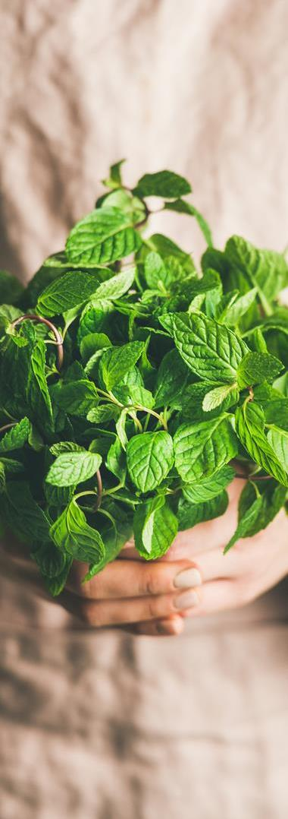

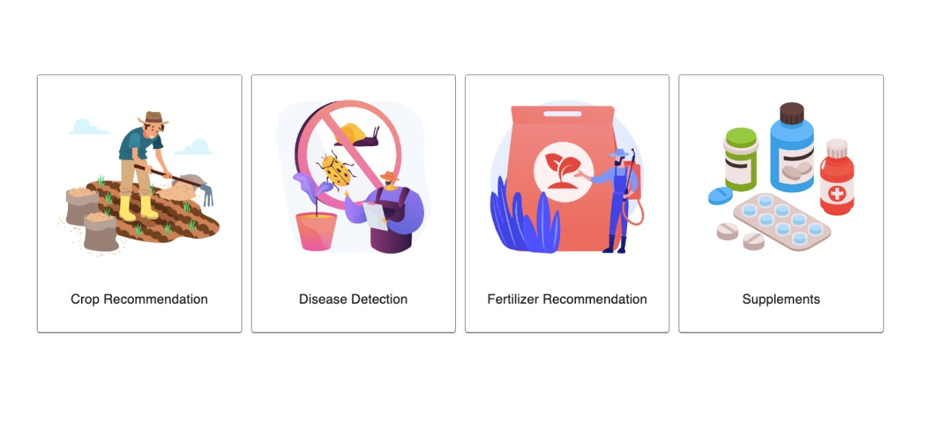
Screenshots 1.home page

Slide 7
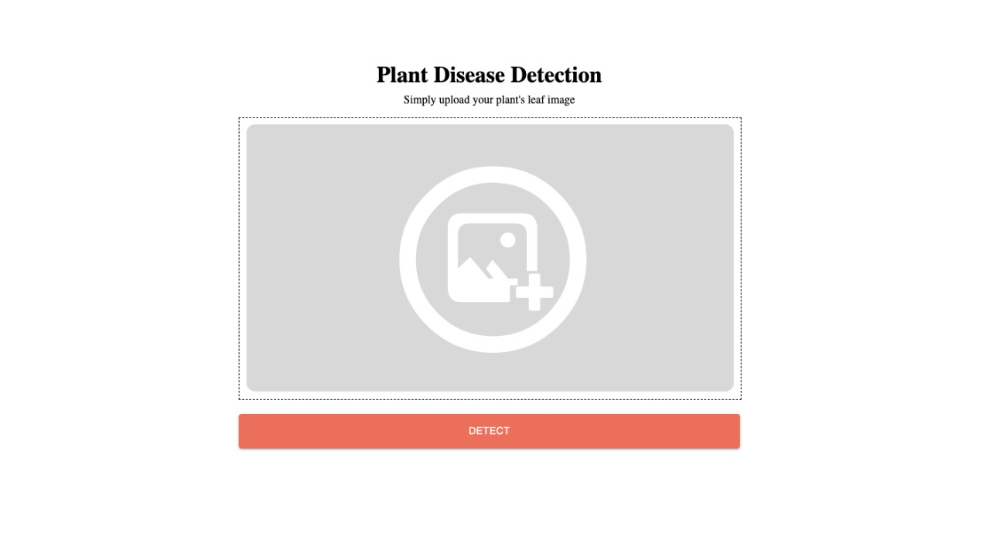
2. Photo Uploading Page
7

Slide 8
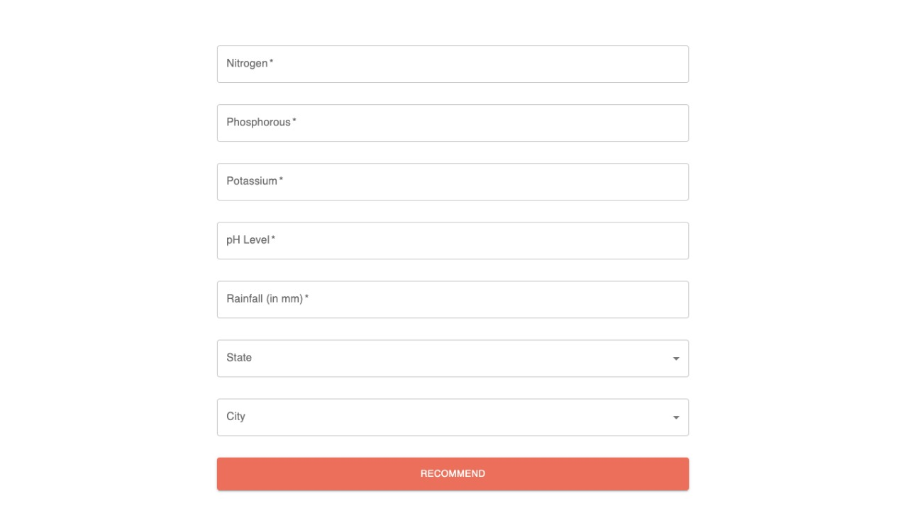
3. Fertilizer Detection - Input
8

Slide 9
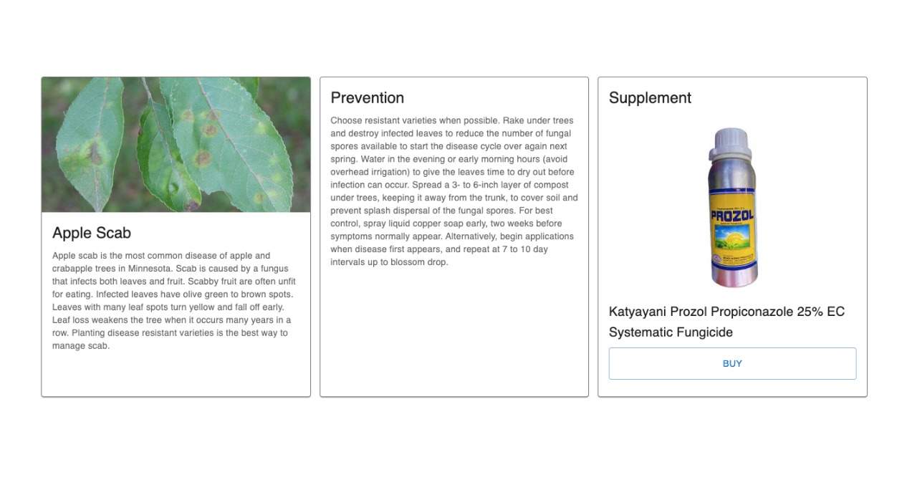
4. Fertilizer Detection System - Output
9

Slide 10
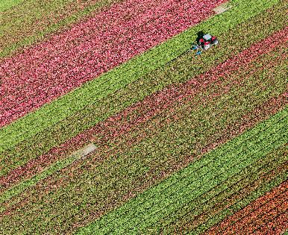
Requirements-
Software –
Programming languages –
VS Code
Jupiter notebook
Postman
HTML
CSS
JavaScript
Python

Slide 11
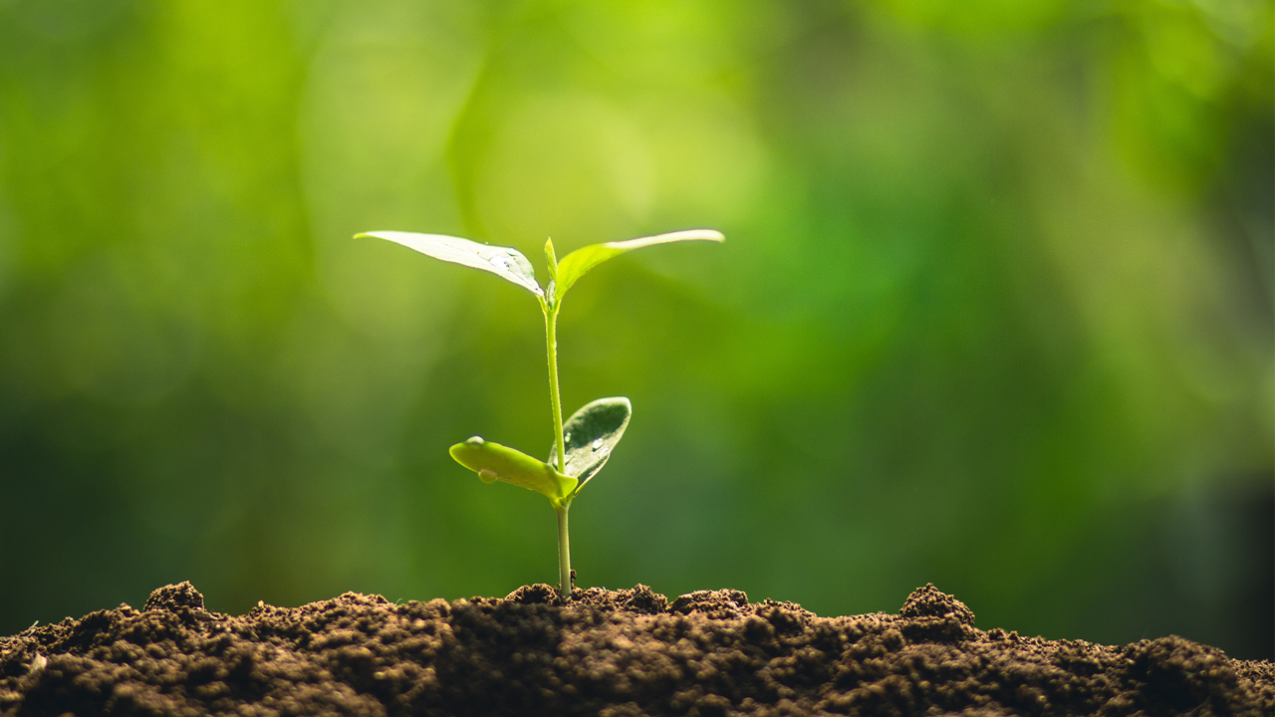
Agriculture is the most healthful, most useful and most noble employment of man.
-George Washington

Slide 12
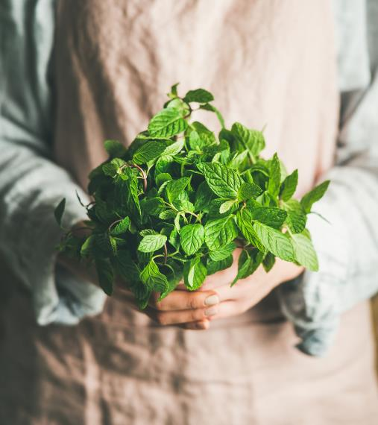
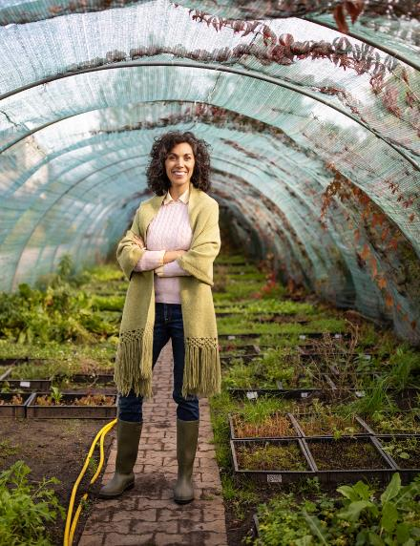
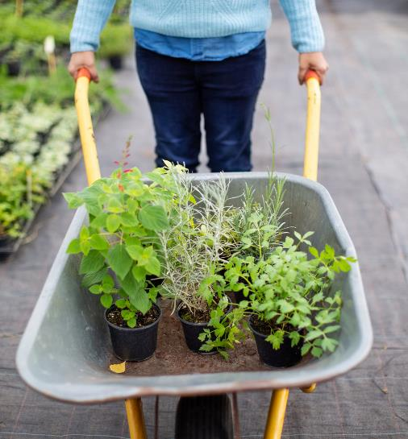
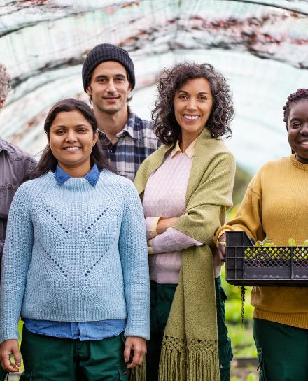
Thank You
Sachin Adulkar – 18101B0067
Vivek Pawar – 18101B0070
Shubham Kothekar – 16101B0018
Aniket Choudhary – 19101B0030

